Slide 1

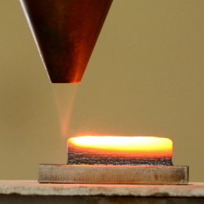
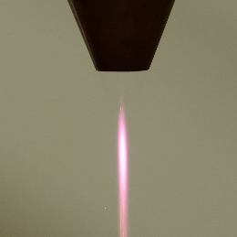
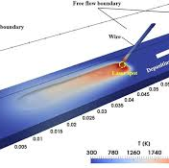

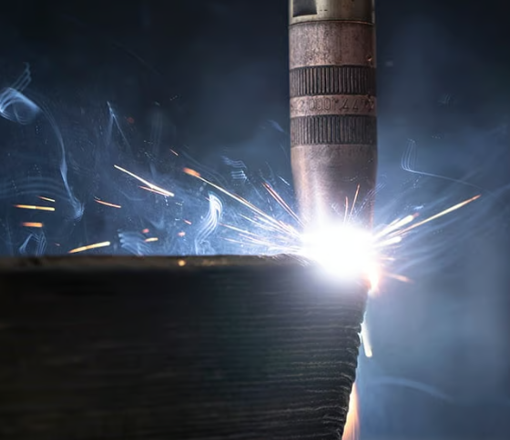
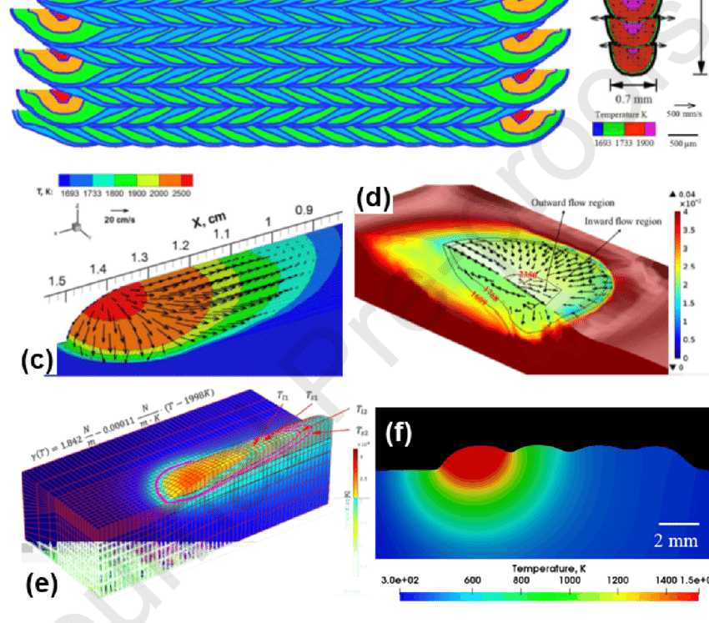
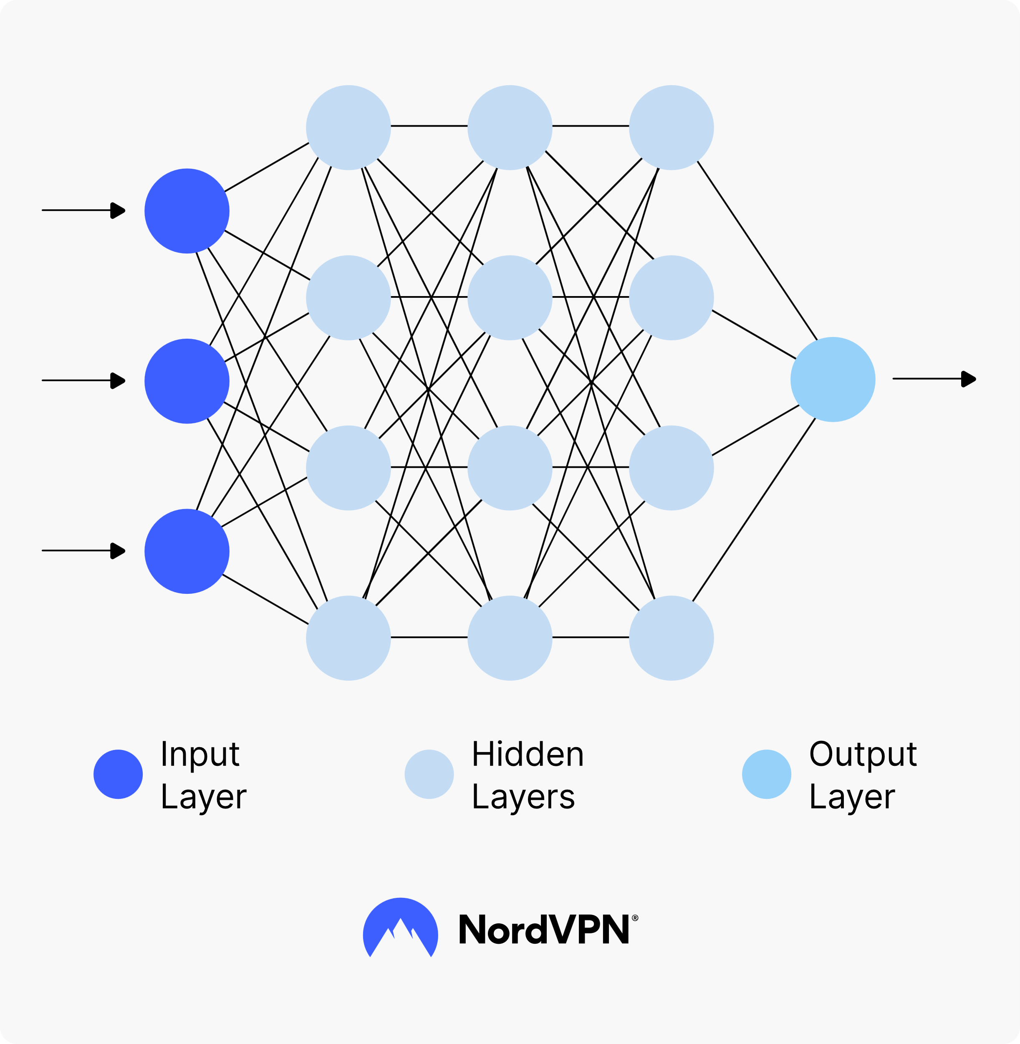
Machine Learning for Thermal Modelling of
Metal Additive Processes
M. Tech Thesis Stage 2
Date : 24th June 2024
Mr. Jagadeeswaran Murapaka
AM22MTECH14001
M.Tech Additive Manufacturing
Department of Interdisciplinary, IIT Hyderabad
Advisor:
Prof. Surya Kumar S, MAE, IITH
Co- Advisor:
Dr. Saketha Nath, CSE, IITH

Slide 2
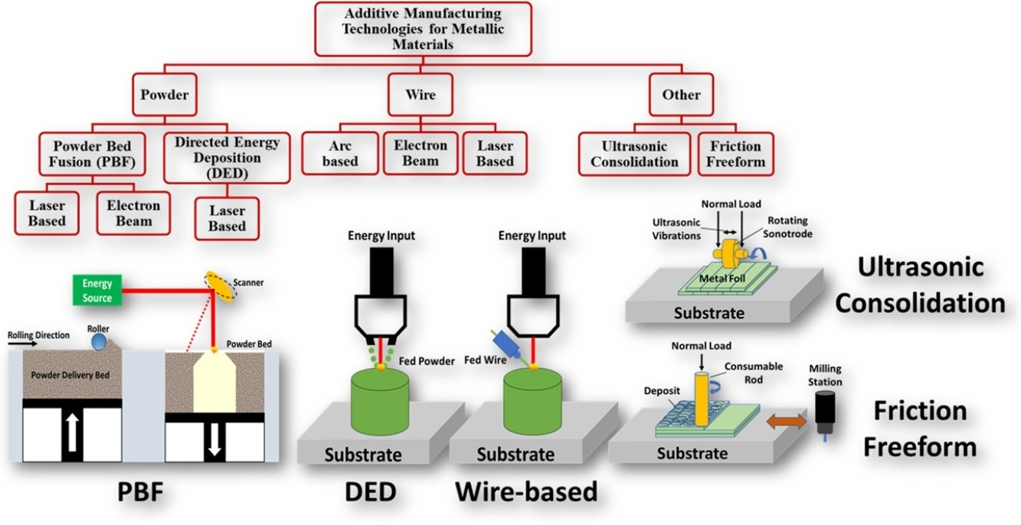
Introduction
Metal Additive Manufacturing: Metal AM encompasses various technologies that fabricate metal components through sequential layer-by-layer deposition directly from CAD models, facilitating the creation of intricate geometries and optimized structures that are often unachievable or impractical with conventional subtractive manufacturing techniques.
Methods of Metal AM:
Directed Energy Deposition (DED)
Uses focused thermal energy (laser, electron beam, or plasma arc)
Powder Bed Fusion (PBF)
Selective Laser Melting (SLM)
Electron Beam Melting (EBM)
Wire Arc Additive Manufacturing (WAAM)
Electric arc to melt and deposit metal wire
Binder Jetting
Liquid binding agent deposited on a powder bed, followed by sintering
Fig 1: Classification of Metal Additive Manufacturing [1]

Slide 3
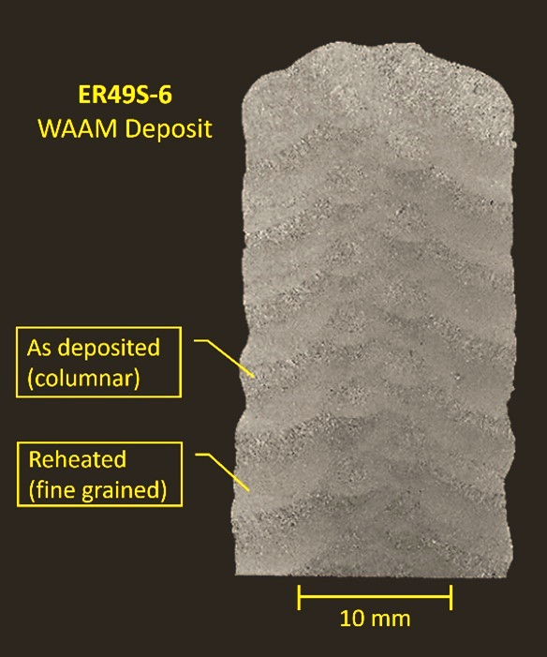
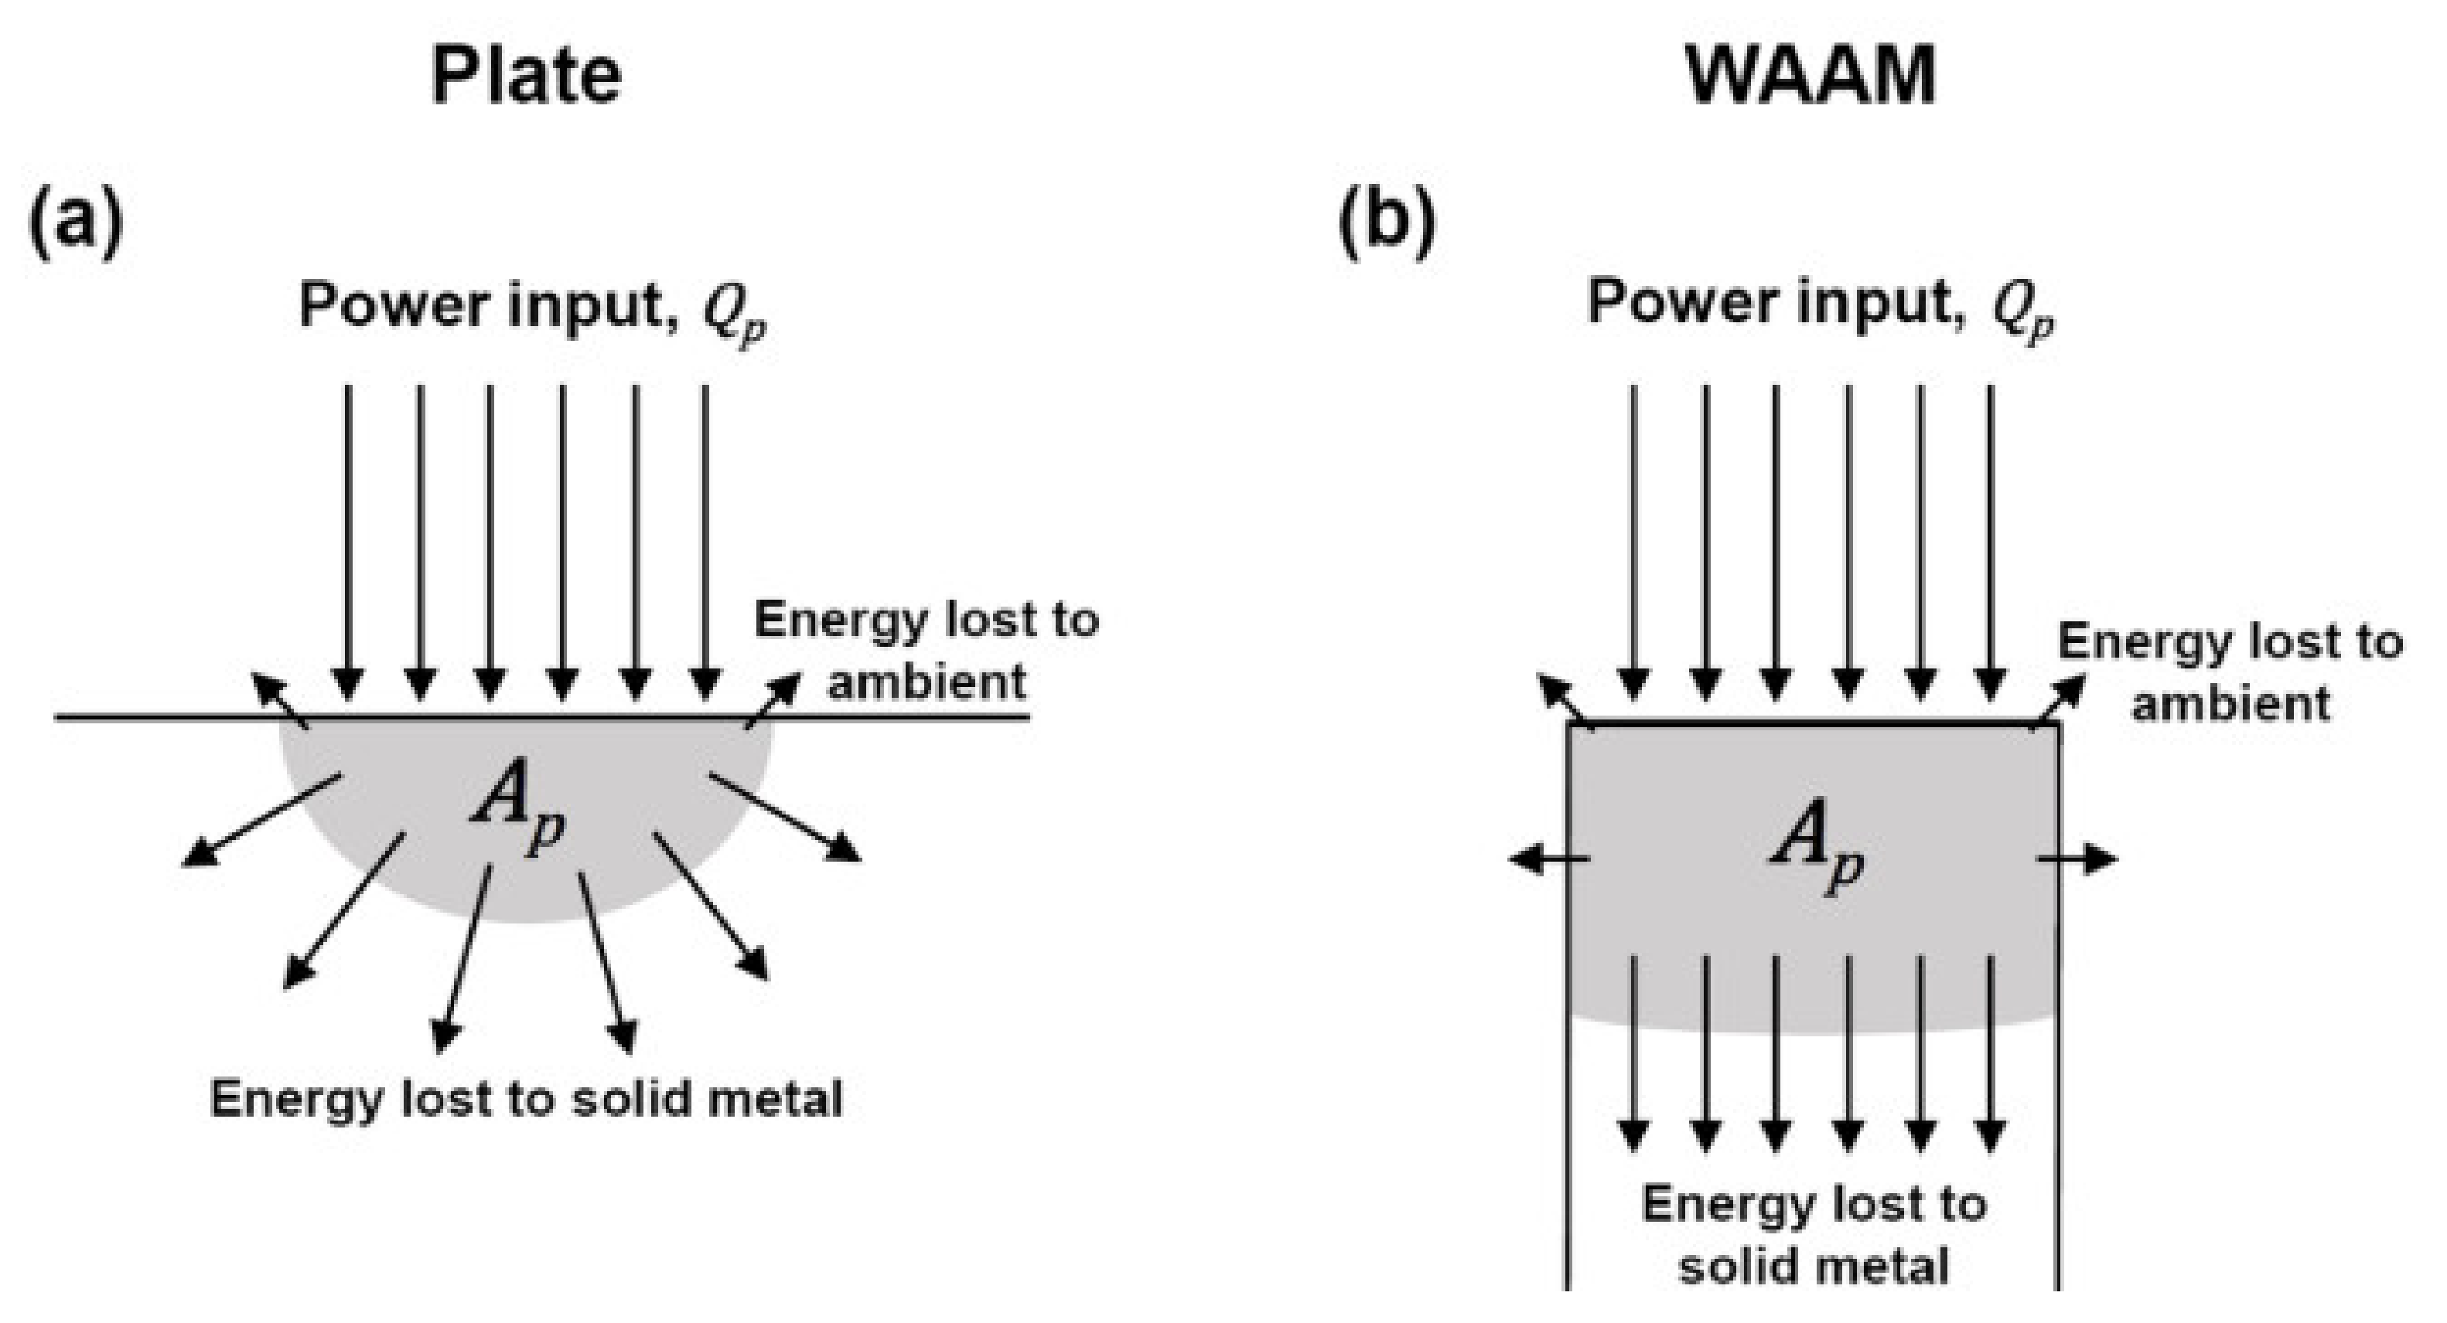
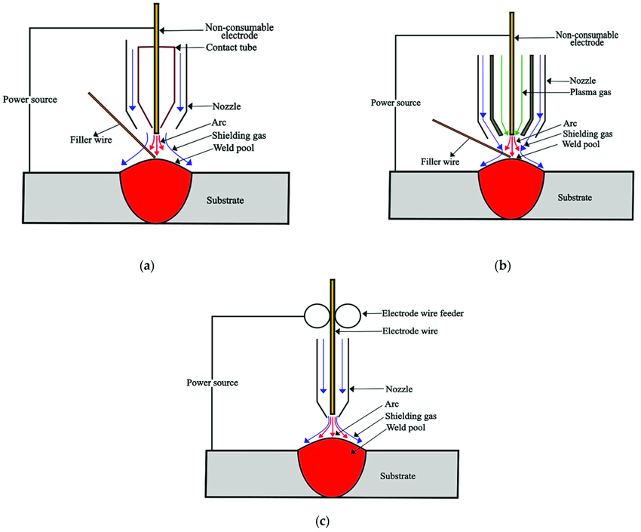
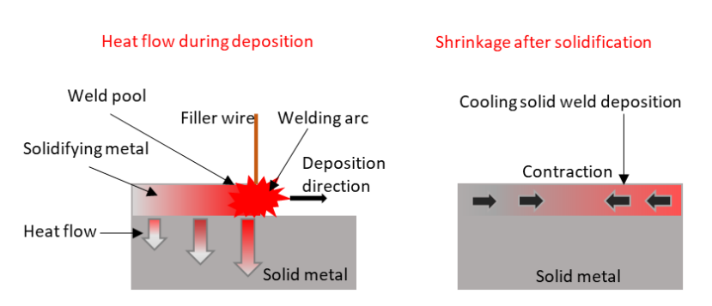
Introduction
Wire Arc Additive Manufacturing (WAAM): A Wire Arc Additive Manufacturing (WAAM) is a cost-effective and faster alternative to other additive manufacturing methods, utilizing consumable electrodes that range from 0.8 to 1.5 mm in diameter.
This process employs the Gas Metal Arc Welding (GMAW) principle for arc creation, protected by inert gas shielding.
Metal is transferred to the workpiece through various modes, including short circuit, globular, or spray transfer, with the Cold Metal Transfer (CMT)
Advantages of WAAM:
High deposition rate, energy-efficient, cost-effective, material-efficient.
Wide range of Materials: Steel, Nickel, Titanium, and Aluminum alloys.
Deposition Rate: 1 to 5 kg/hr.
Improved buy-to-fly ratio, lower part cost.
Challenges in WAAM-
Heat Accumulation because of reheating
Residual stress, Distortion
Non-uniform properties throughout the built
Fig 2. Types of WAAM processes. (a) GTAW; (b) PAW; (c) GMAW. [2]
Fig 3: Direction of heat flow in (a) Arc welding of plate (b) multilayer built in WAAM [Kai Treutler,2021] [3]
Fig 4: Schematic of Heat flow in AM [Vishwanath Nagallapati,2023][4]
Fig 5 : Macrographic cross section of a typical WAAM deposit (near top), [Jim Galloway, 2022][5]

Slide 4
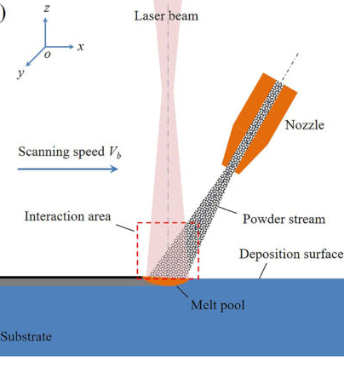
Introduction
Laser Directed Energy deposition (L-DED): Laser Directed Energy Deposition (L-DED) uses fiber, diode, or CO2 lasers (500 W to 20 kW) to melt and deposit metal powder or wire feedstock. It achieves deposition rates of 0.5 to 10 kg/h with spot sizes of 0.5 to 3 mm and scanning speeds of 200 to 2000 mm/min. Suitable for titanium, stainless steel, and Inconel, L-DED is ideal for large-scale parts, complex geometries, and repairs, with real-time monitoring ensuring quality and efficiency.
Advantages of L-DED:
High Deposition Rate: Achieves rates of 0.5 to 10 kg/h
Versatility in Materials: Capable of processing a variety of metals and alloys such as titanium, stainless steel, and Inconel.
Precision Control- Can control laser dia, resulting high detailed and accurate build
Challenges in L-DED-
High Thermal Input – Can cause residual stresses and distortion.
Heat Affected Zone: Non-uniform properties throughout the built
Thermal Cracking: Risk of thermal cracking due to rapid cooling and heating cycles
Fig 6: Schematic of L-DED process [6]

Slide 5
Motivation
Problem statement:
To mitigate residual stress in these Metal AM processes, these are some techniques.
Preheating the Substrate- Reduces thermal gradients and residual stresses.
Shorter Deposition Paths or Smaller Segments - Improves heat distribution control
Effective Deposition Patterns - Inward spiraling reduces stress concentrations
Increasing Scanning speed and reducing the height of each deposited layer- Lowers heat input per unit length.
Thermal modeling helps assess and optimize these techniques for better process quality and accuracy.
Existing Approaches:
Huge dependency
Experimental
Numerical Methods
Data Driven ML
Time consuming, Limited observation
of process variation
Computationally expensive; Complex Meshing etc.,
Require Lot of data, Multiple model training, Complexity of model
Although the above methodologies are in practice and has their own advantages, Physics informed Machine learning (PIML) methodology, has its own advantage of modelling the process physics without or with very limited amount of data
PINNS are formulated very recently in 2019 by George Karniadakis et al.

Slide 6
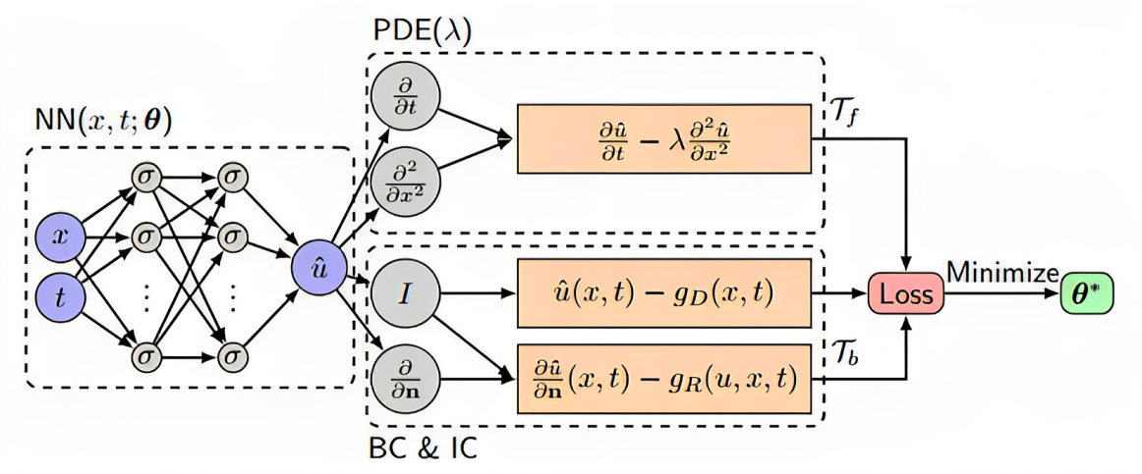
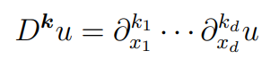
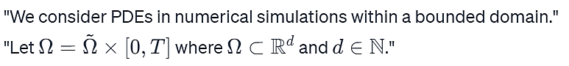
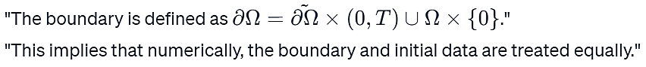
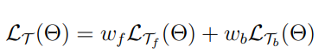
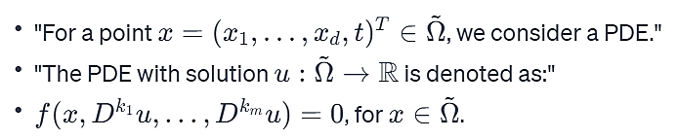
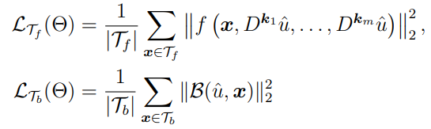
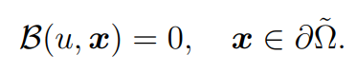
Physics Informed Neural nets (PINNS)
General PINN Framework:
Training Process of PINN:
1. Construct Neural network which acts as surrogate solution for u
2. Define your Domain and PDE:
Fig 7: PINN architecture for 1D diffusion equation[7]
3. Boundary and Initial Conditions:
DOMIAN:
Backprop
4. PINN Loss functions:
BOUNDARY AND INITIAL CONDITIONS:
FORMATION OF PDE:
Where,
6

Slide 7
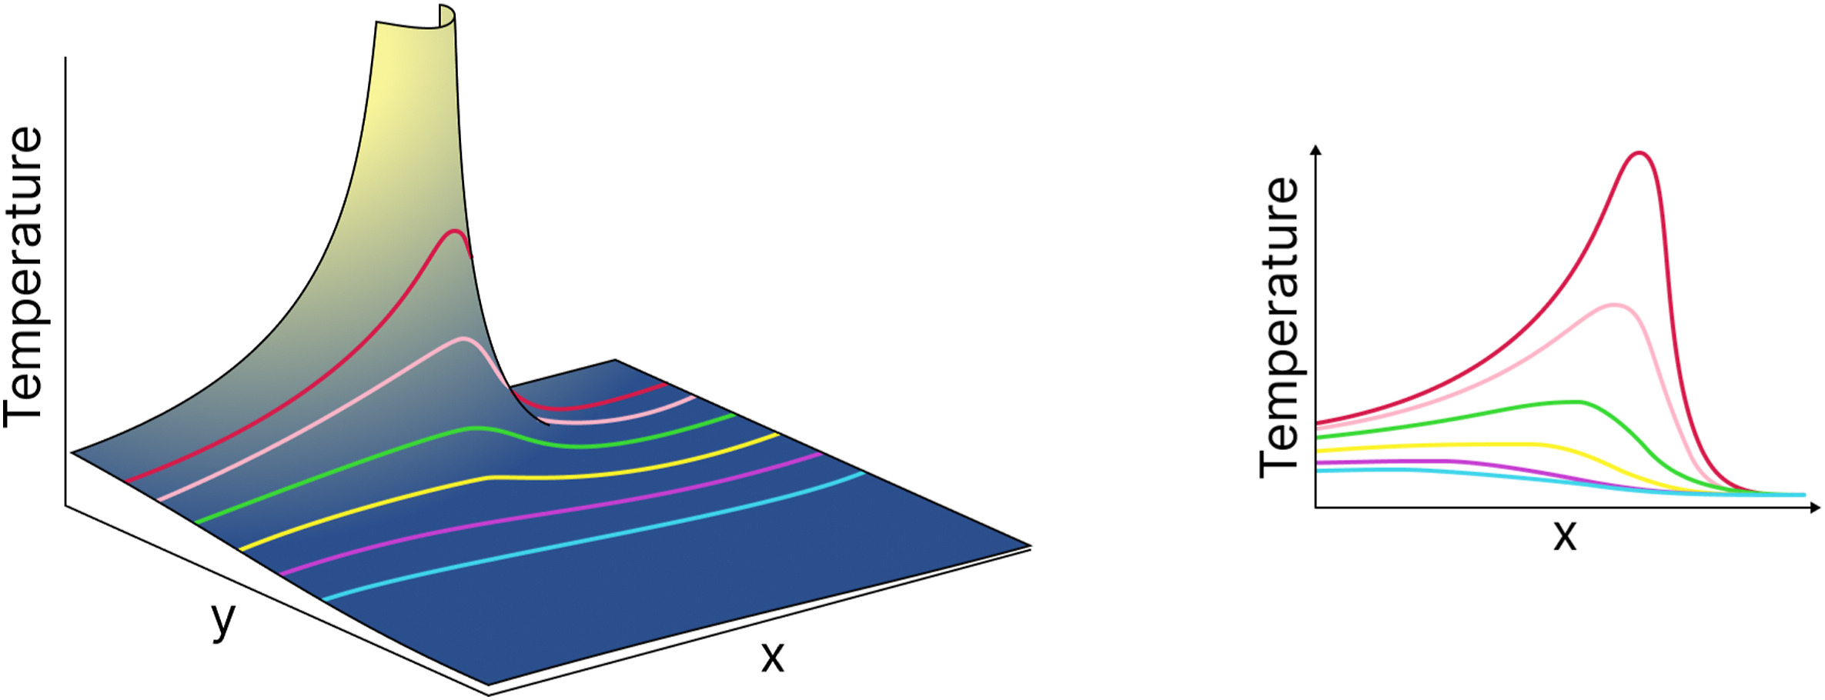
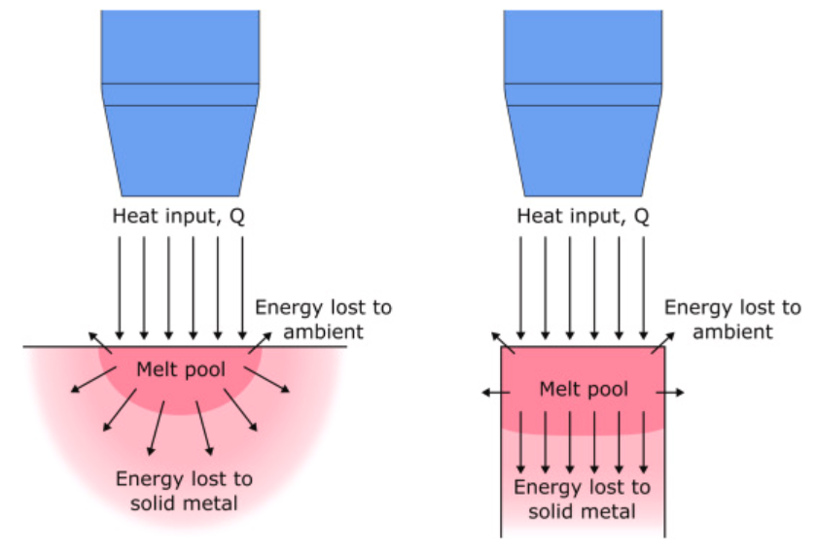
Literature survey
Analytical Modelling:
The foundations of the analytical modelling of WAAM are the development and application of the heat transfer equation for moving heat sources in arc welding by Rosenthal’s steady state solution [Kai Treutler et al.,, 2021][3]
Analytical results deviate from experimental data if radiation and convection is ignored in heat transfer modeling. [Nasiri et. al, 2019][8]
Also, the Temperature at origin of heat source may increase beyond Melting point of the material. [Nasiri et. al, 2019][8]
Fig 8: Infinite temperature at start of heat source[Nasiri et. al, 2019] [8]
Melt pool differences between arc welding and WAAM affect melting efficiency due to heat transfer variance.[Mohebbi et al., 2018][9]
Fig 9: Difference of melt pool cross sections between arc welding and WAAM [Mohebbi et al., 2018][9]

Slide 8
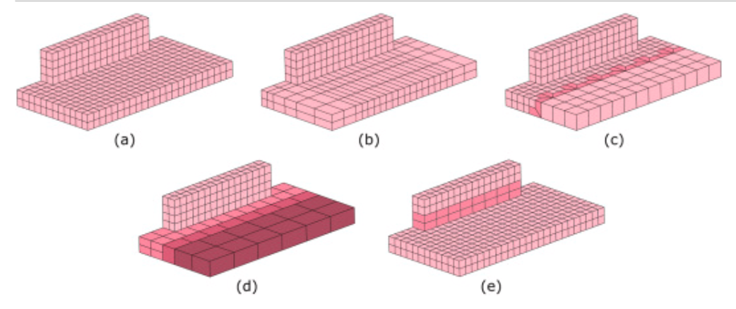
Literature survey
Basic analytical models are insufficient for complex welding [Kai Treutler, 2021][3]
Advanced models like Gaussian distributions are needed for temperature-varying materials and paths.[Kai Treutler, 2021][3]
Numerical method Approaches:
Energy conservation is fundamental to finite element and other numerical methods.
Hexahedral elements are preferred in WAAM for linear, multi-layer depositions [Filippo Montevecchi, 2017][10]
Adaptive Meshing is recommended for mesh coarsening and element merging in lower layers of deposited material.[Denlinger et al., 2014 , Jayanath and Achuthan, 2018][11]
(d)
Fig 10:Meshes: (a) regular, (b) structured biased, (c) unstructured with templates, (d) layer-by-layer coarsened [Denlinger et al., 2014 , Jayanath and Achuthan, 2018][11].

Slide 9
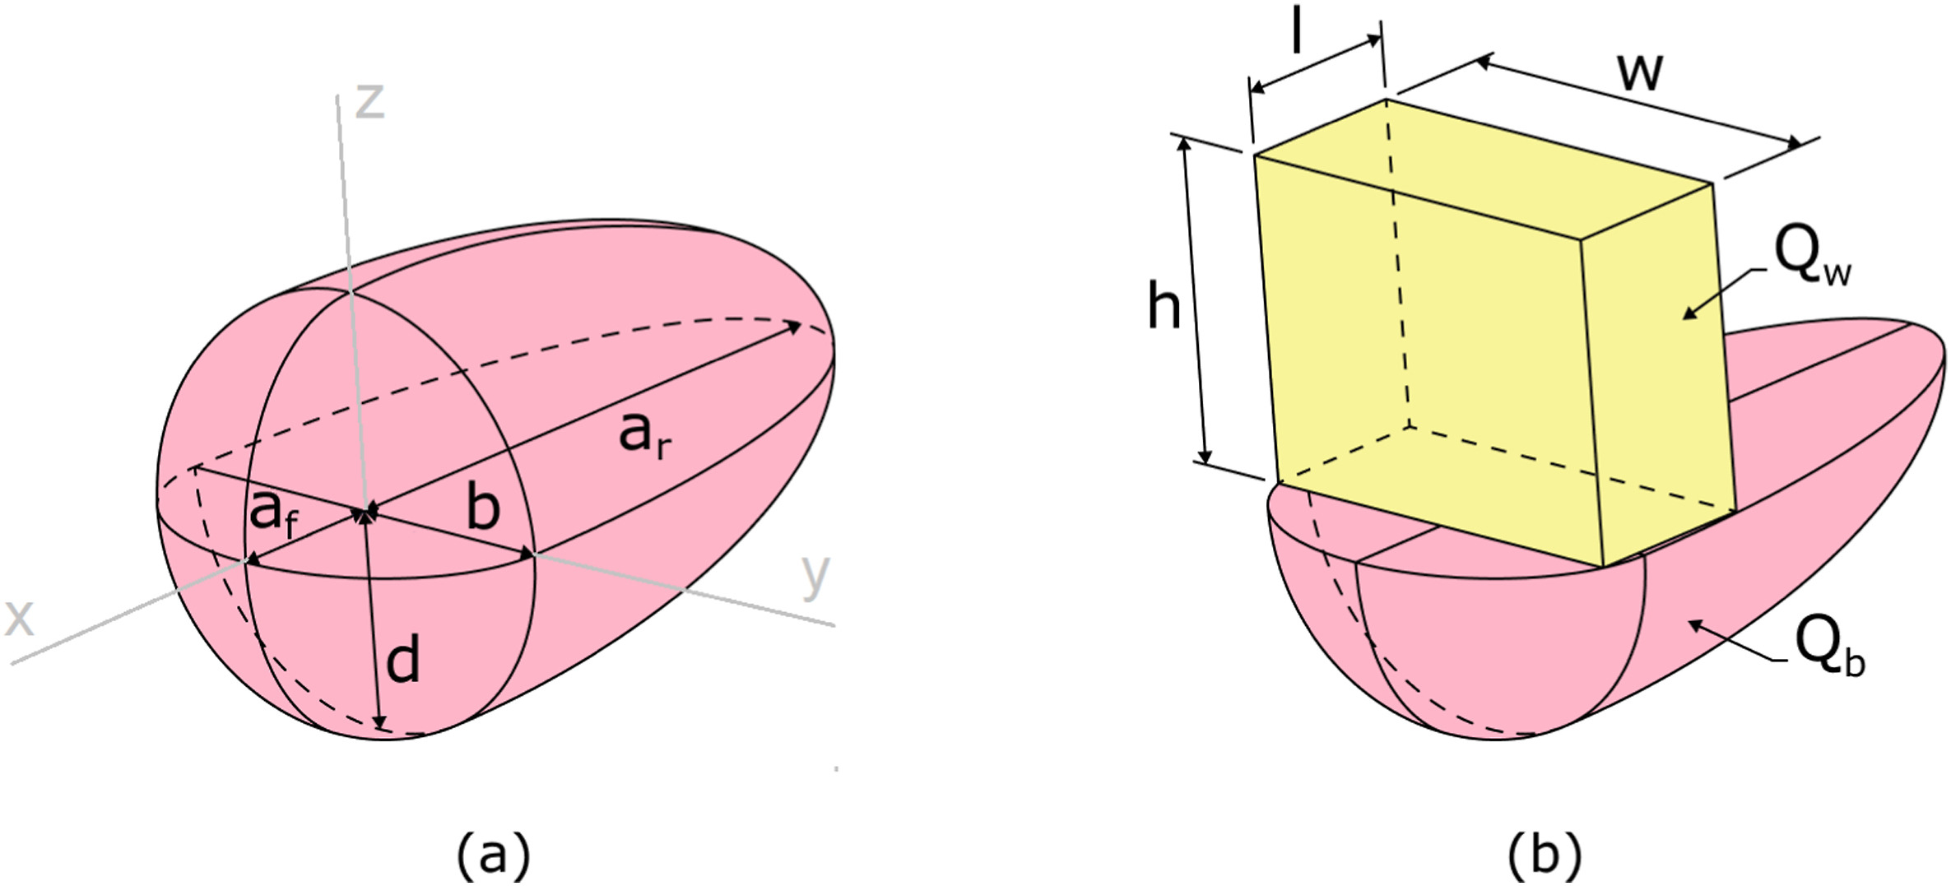
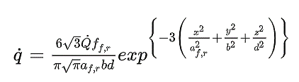
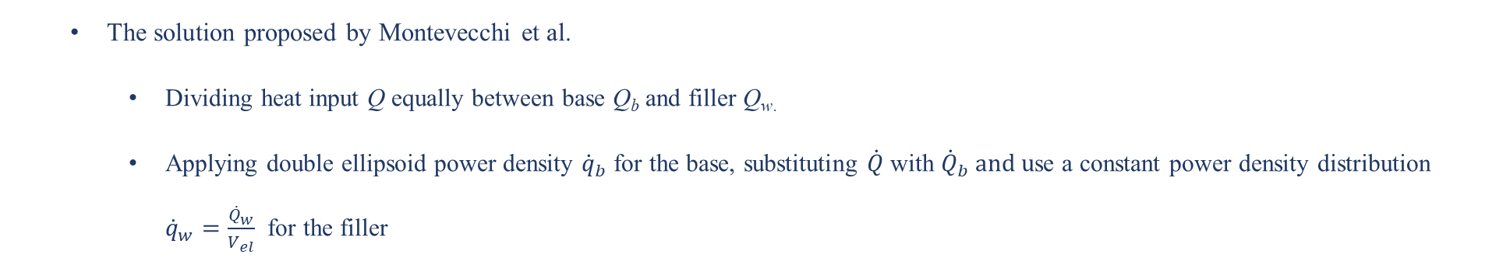
Literature survey
Heat source Model:
The Goldak double ellipsoid heat source model commonly used in the FEM modelling of WAAM [Goldak et al, 1984]
Asymmetric Gaussian Distribution in X (Feed direction)
b= Half width mm
d= Depth of weld pool mm
af, ar = Semi axis length mm (front and rear)
Fig 12: Goldak double ellipsoidal heat source [Kai Treutler et al.,, 2021][3]
It has been reported that double ellipsoid heat source model spreads the thermal energy through the melt pool volume more accurately than others [Ding et al.,2014]
In some cases, the calculated temperatures can go above the evaporation temperature and require modification of the intensity parameter in equation [Graf et al.,2018, Ahmad et al.,2018][12]
The solution proposed by Montevecchi et al.
Dividing heat input Q equally between base Q_{b}​ and filler Q_{w​.}
Applying double ellipsoid power density ${\dot{q}}_{b}$​ for the base, substituting $\dot{Q}$with ${\dot{Q}}_{b} and u$se a constant power density distribution ${\overset{˙}{q}}_{w}=\frac{{\overset{˙}{Q}}_{w}}{V_{el}}$ for the filler
Fig 13: Goldak double ellipsoidal heat source [Kai Treutler et al.,, 2021][3]

Slide 10
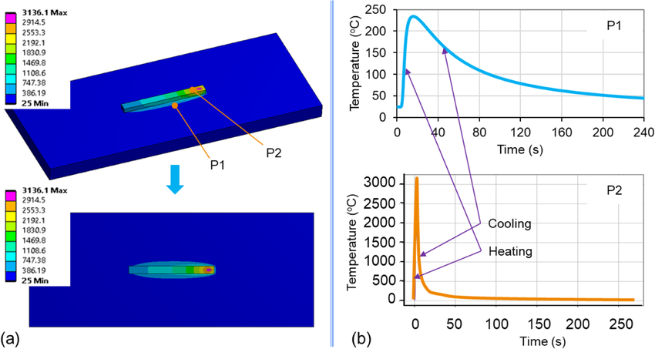
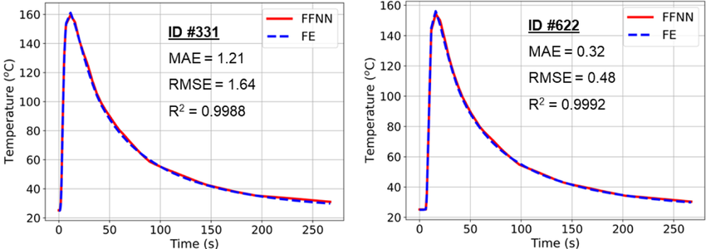
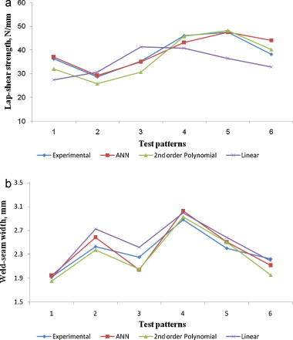
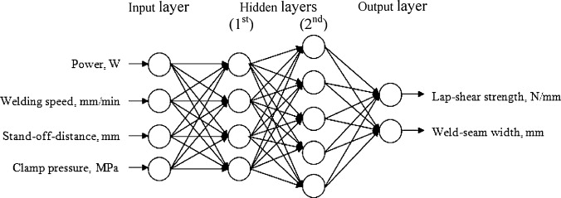
Literature survey
Data Driven ML:
Van thao Le et.al [12]., A surrogate machine learning (SM) model was developed to predict temperature history in WAAM of single weld tracks. The FE model was validated through experiments. The trained SM model accurately predicts temperature history with over 99% accuracy in just 38 seconds, compared to 5 hours for the FE model.
Bappa Acherjee et al. [13] link laser welding parameters with lap-shear strength and weld-seam width using ANN. Sensitivity analysis shows the influence of inputs. Fig. 16 compares experimental and predicted results for MRA and ANN models.
Fig 14: (a)Bead simulation heating and cooling cycles (b) comparison with actual results [12]
Fig 15.Back-propagation neural network used for predicting lap-shear strength and weld-seam width [13].
Fig. 16 Comparison between ANN and MRA models for prediction of (a) lap-shear strength and (b) weld-seam width, using test patterns [13].

Slide 11
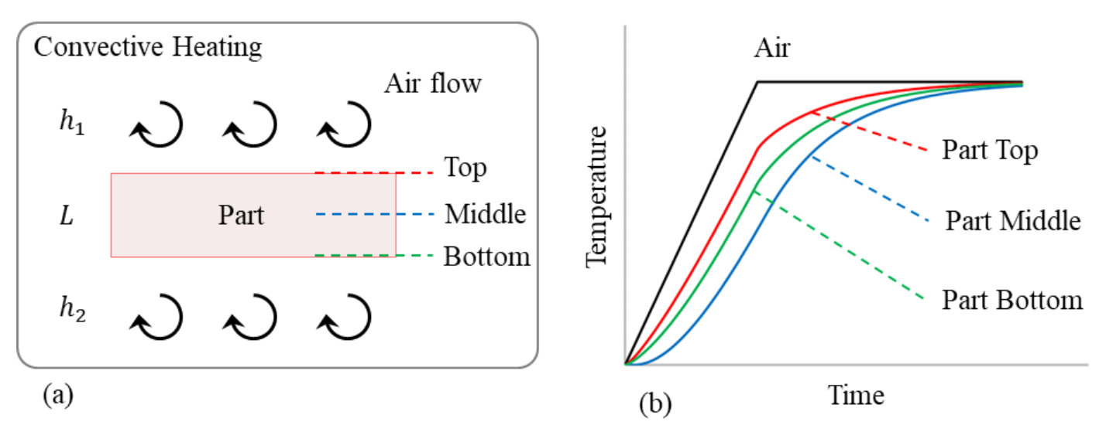
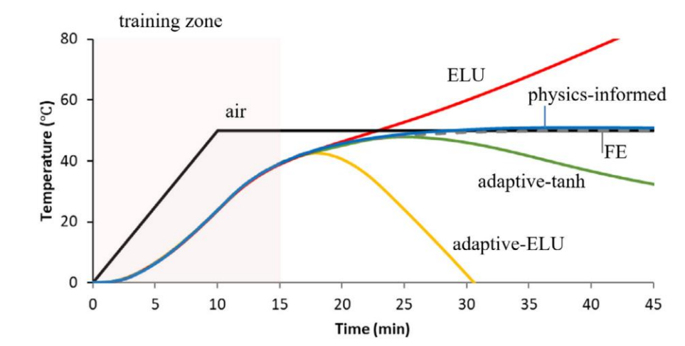
Literature survey
PINNS:
Navid et al., 2020 compared data-driven predictions with Finite Element (FE) method results, particularly for the part's center temperature after extensive training.
Fig 17 (a): Convective heating of a part[Navid et al., 2020 ][14]
Fig 17 (b): Comparison analysis of PINN with data driven for middle section of the part [Navid et al., 2020 ][14]
They found that, after 50000 epochs, only PINN approach is correctly able to capture the process and physics and the data driven predictions are deviated from the true temperature curve

Slide 12

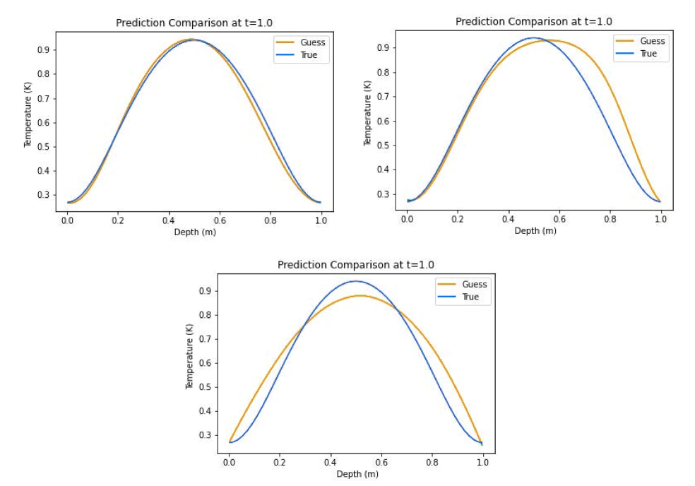
Literature survey
PINNS:
PINNs applied to a 1-D Advection–Diffusion–Reaction equation modeling laser energy interaction with skin tissue, Brett Bowman et al.,2023
Fig 18: From left to right: epidermis, dermis, and fat.[Brett Bowman et al.,2023][15]
Collocation points for the PINNs were created using Latin Hypercube sampling.
It was noted that Hybrid and Tanh activation functions might be most effective for PDEs with source terms in PINN models.
Hybrid
Tanh
ELU
Fig 19: Predicted temperature profile along depth.[Brett Bowman et al.,2023][15]

Slide 13
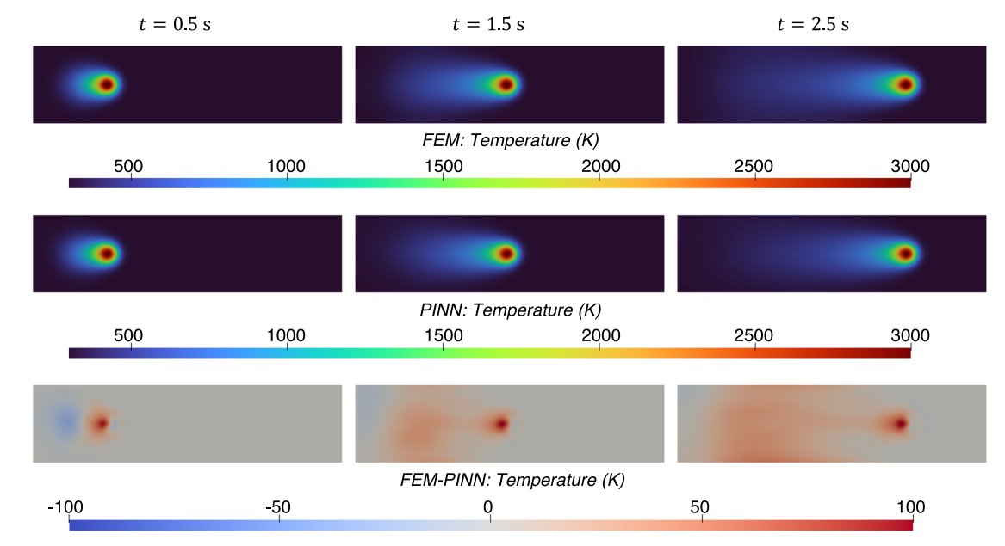
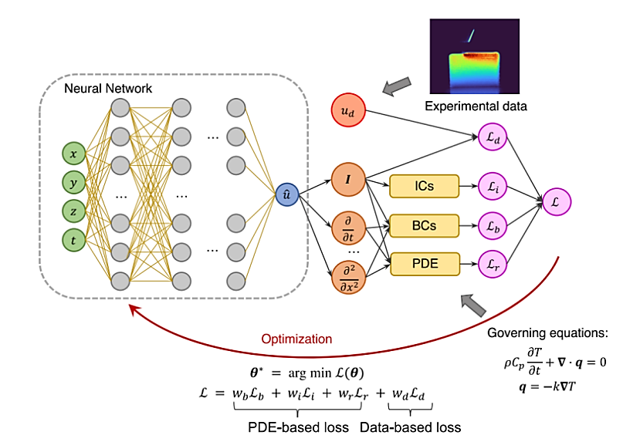
Literature survey
PINNS:
Liao et al., used physics-informed NN to construct a hybrid physics-based data-driven thermal modelling technique for AM operations.
In order to anticipate full-field temperature history and identify unidentified material and process factors, partially seen temperature data from an infrared camera is integrated with the laws of physics.
PINN predicted temperature field matches well with the FEM results, with the RMSE of 14.07 K.
Fig 15: Hybrid PINN architecture [Liao et al., 2023] [16]
Fig 16: Temperature profile upto 2.5 sec from top view [Liao et al., 2023][16]

Slide 14
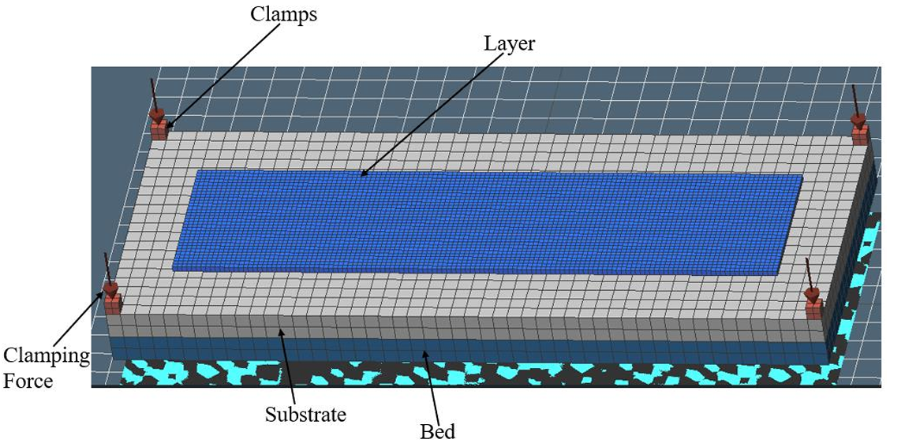
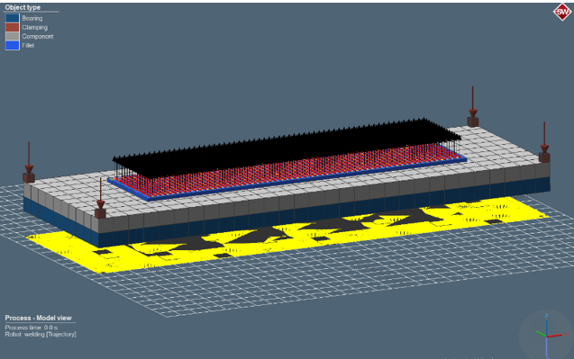
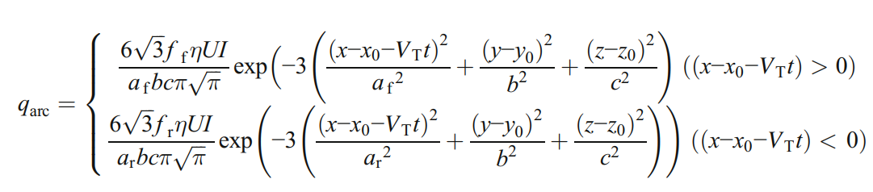
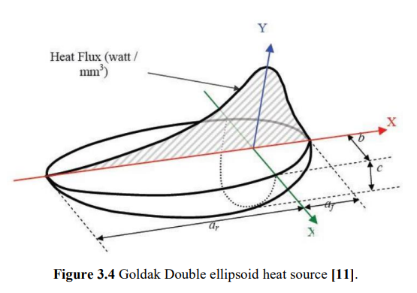
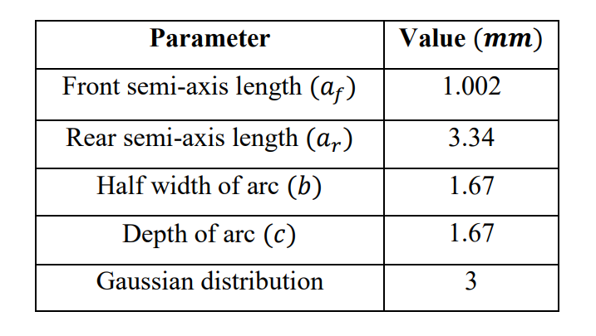
ML for AM: Data Driven Approach
Applied on WAAM:
Objective:
The goal is to predict the temperature profile of the material given the tool path and initial temperature profile.
Data Generation:
Abaqus software is used for domain and tool path meshing.
Simufact Welding is employed for simulations
Assigning material and heat source parameters
Extracting time-temperature records through post-processing
The simulation generates the temperature profile for:
Contour pattern
Zig-zag horizontal pattern
Zig-zag vertical pattern
Fig 16: Simufact welding software interface
Table 1: Goldak Heat source parameters
Fig 17: Goldak Double Ellipsoidal heat source

Slide 15
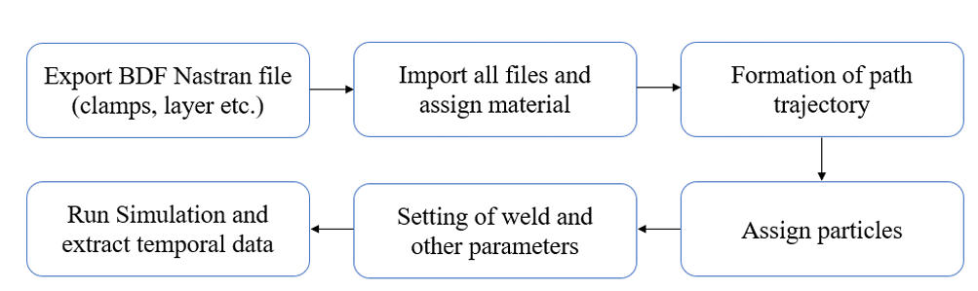
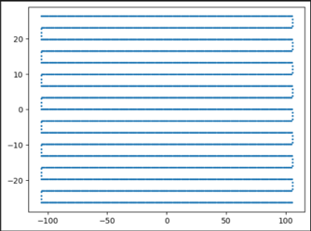
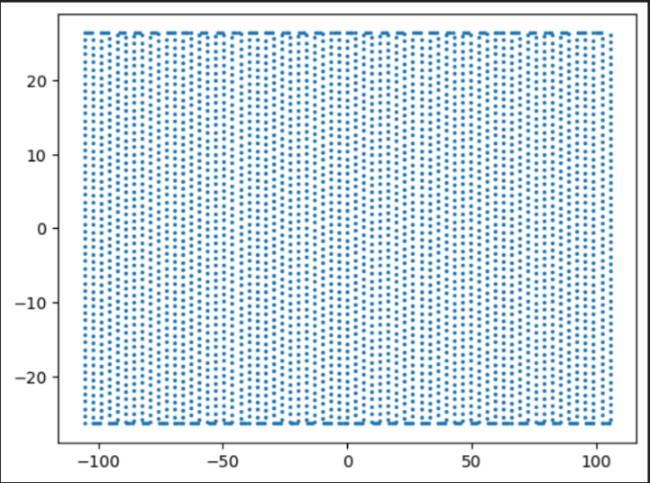
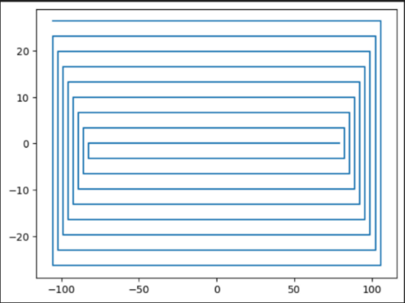
ML for AM: Data Driven Approach
Category | Parameter | Value
Space and Time Domain | Space and Time Domain | L*W= 211.2*52.8 mm
 | Time Steps | 1717
Process Parameters | Current (I) | 120 A
 | Voltage (U) | 15.4 V
 | Heat Transfer Efficiency (η) | 0.9
 | Travel Speed (V) | 10 mm/s
Material Properties | Material | 316L_NSWH
 | Density (ρ) | 7.966e-3 g/cm3
 | Emissivity (ε) | 0.35
 | Convective Heat Transfer Coefficient (h) | 2e-5
 | Temperature Range | 1723.15 K, T₀ = 293.15 K
Data Generation:
Fig 18: Workflow of Data Generation
Table 2: Process and Material Parameters
Dimensions: 211.2 x 52.8 mm, step : 3.3 mm
Fig 19: (a) Zigzag Horizontal Pattern (b) Zigzag Vertical (c) Contour Pattern
15

Slide 16
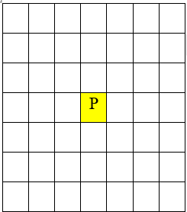
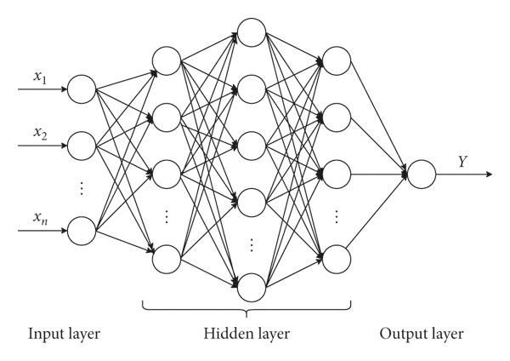
ML for AM: Data Driven Approach
Model Architecture and Training:
Torch position at time t
Model
Temperature output of point P at time t+k
Substrate
Torch position at time t+k
Fig 20: Model schematic
Fig 21: Working Methodology
A Recurrent Neural Network (RNN) architecture is employed.
To predict temperature at point P at time t+k:
Utilizes temperatures from a 7×7 grid of neighboring points at time t
Processes this temperature configuration and the relative position of the torch at times t and t+k
The model predicts temperature at point P at time t+k.
By iteratively applying this model, the temperature profile of the substrate throughout the process is generated, accounting for the thermal effects of the moving torch.
Category | Parameter | Value
Model Training | Patterns considered for training | Zigzag vertical and horizontal patterns
 | Testing pattern | Contour In pattern
 | Shape of neighbors | (7,7)
 | Number of neighbors (num) | 49
NN Related Parameters | Model architecture Learning rate and batch size | [2*num, 6*num, 12*num, 6*num, 2*num, num] Lr= 0.0001 bs =128
 | Loss term, optimizer | MSE loss, Adam
Table 3: Training and Model Parameters

Slide 17
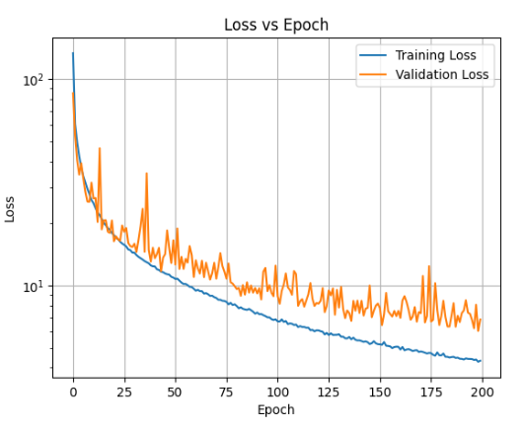
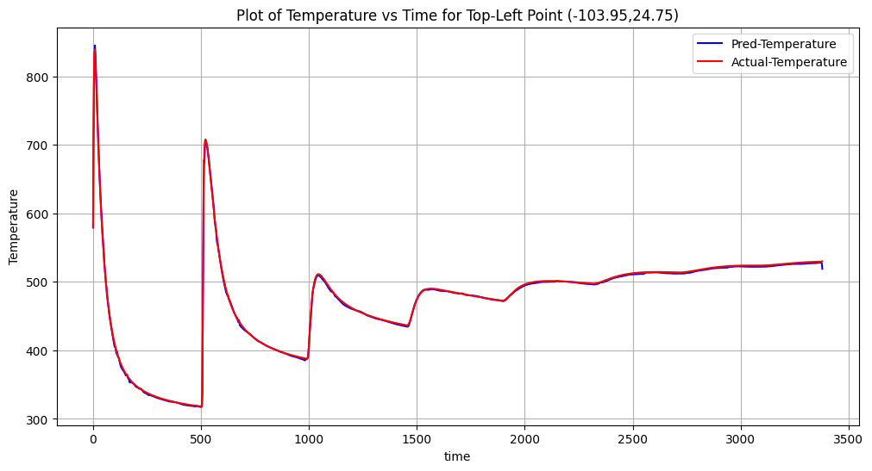
ML for AM: Data Driven Approach
Model Evaluation: Training of Model took around 5.5 hr on P100 GPU
Sequential Actual Temperature based Prediction:
The model was tested for predicting the temperature profile with a contour tool path.
Actual temperatures from Simufact welding were used as reference.
The model predicts temperatures at all points for time t+2k, using actual temperatures from time t+k.
Observed that Predicted temperatures closely match actual temperatures from Simufact welding with almost 96.5% accuracy.
Fig 23: Comparison analysis of Sequential Act.based Prediction model
Fig 22: Loss curves

Slide 18
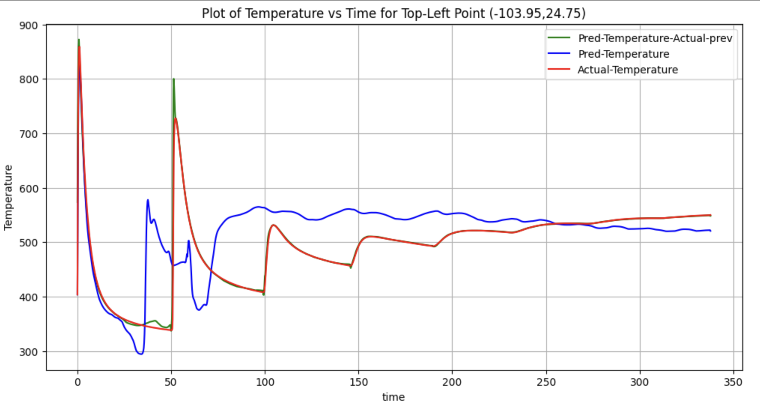
ML for AM: Data Driven Approach
Sequential Iterative Prediction:
Instead of using actual temperatures at t+k for predicting t+2k, the predicted temperatures at t+k are used.
This iterative process continues with each predicted temperature serving as the input for the next step.
The process repeats until the end of the thermal cycle.
Observation:
Actual temperatures (red curve) show significant initial peaks that stabilize over time.
Model predictions (blue and green curves) closely follow initial peaks, indicating good initial calibration.
Predicted temperatures (blue curve) initially match actual temperatures but diverge over time, suggesting accuracy in short-term but discrepancies in long-term predictions.
The green curve, using actual previous step temperatures, enhances prediction accuracy and maintains closer alignment with actual temperatures.
Fig 24: Comparison analysis of Sequential Iterative Prediction

Slide 19
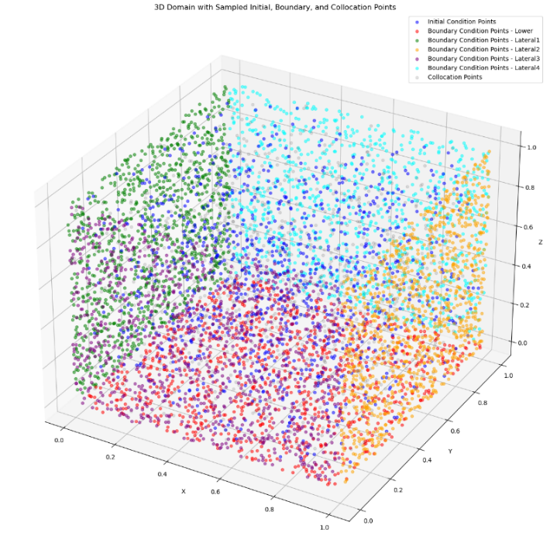




ML for AM: PINN Approach
Trail Implementation 3D Laser Material Processing:
Dynamic heat conduction in bulk materials can be modelled by the time dependent heat conduction equation, a partial differential equation in space $\vec{x}$ and time (t)
Latin Hypercube sampling is utilized for entire domain sampling.
Governing Equation and Boundary condition:
$$c_{p}\frac{∂}{∂t}u\left(\vec{x},t\right)=\frac{κ}{ρ}Δu\left(\vec{x},t\right)+\dot{Q}\left(\vec{x},t\right) ,$$
$\dot{Q}=\frac{2⋅P_{L}}{π⋅r_{\text{spot}}^{3}}⋅\exp\left(−2⋅\frac{r_{\text{focus}}^{2}}{r_{\text{spot}}^{2}}\right)$
The temperature field is modelled within a finite cube. To its lower base a Dirichlet boundary condition (BC) was applied and set to 0.
For the heat source a Gaussian beam profile with a laser power P_{L}= 1W and a velocity of 1 mm/s was used. The heat source is modelled by:
For the four lateral faces (F) the Neumann BC was
$\frac{∂}{∂t}u\left(\vec{x},t\right)=0.1$
Fig 25: 3D point discretization of domain

Slide 20




ML for AM: PINN Approach
Model Evaluation:
Parameter | Value
Initial Temperature | 0 throughout domain
Laser Power | 1 W
Velocity Components | (v_x=1, v_y=0, v_z=0)
Sampling Strategy | Latin Hypercube
Initial Condition Points | 1000
Boundary Condition Points | 1000
Collocation Points | 8000
Optimizer | Adam
Learning Rate | 0.001
Epochs | 15000
Input Layer Nodes | 4 (t, x, y, z)
Hidden Layers | 4
Nodes per Hidden Layer | 50
Output Layer Nodes | 1 (temperature)
Activation Function | Tanh
Fig 26: Loss curves
Table 4: Network and Material Parameters
The training took only 12 min on RTX 2080 Ti GPU
Fig 27: 3D prediction of whole domain at t= 0.1, 0.2 and 0.3 sec

Slide 21


ML for AM: PINN Approach
Assumptions considered for study of AM processes:
The latent heat of phase change was neglected in the material properties because it had little impact on the temperature distribution (Single phase study only)
The internal flow of the melt pool during deposition and heat loss from evaporation were also ignored.
Initial temperature is considered as room temperature.
Bottom surface of the plate is kept as insulated surface.
3D temperature field without auxiliary data in process of laser DED:
where:
$η$ is the laser absorptivity.
$P$ is the laser power (W).
$r$ is the radius of the laser beam (mm).
$x_{0}$ and $y_{0}$ are the initial coordinates of the laser spot. mm
$v$ is the velocity of the laser movement. mm/s
$t$ is the time.s
The problem is modeled using a partial differential equation (PDE) that describes
heat conduction and includes boundary conditions for convection and radiation.
Governing equations:
The governing equation of the transient heat conduction in additive manufacturing (AM)
can be written as: $ρC_{p}\frac{∂T}{∂t}+∇⋅q=0$
According to Fourier's law of heat conduction, the heat flux $q$ is given by:
$q=−k∇T \left(W/{mm}^{2}\right)$

Slide 22


ML for AM: PINN Approach
The Gaussian Surface heat flux of the laser $q_{\text{laser} }$ is defined as:
${ q}_{\text{laser} }=\frac{2Pη}{πr^{2}}exp⁡\left(−2\frac{{\left(x−x_{0}−vt\right)}^{2}+{\left(y−y_{0}\right)}^{2}}{r^{2}}\right)⋅\left(t≤t_{\text{end} }\right)⋅(t>0)$
Boundary Condition Implementation:
The heat source flux is assumed to be applied only on the top surface, while the convective and radiative heat flux are applied on all surfaces. These can be expressed as:
For the surfaces at $x=±x,y=±y$ :
$$k\frac{∂T}{∂n}=+q_{rad}+q_{conv}$$
For the surfaces at $z=±z$ :
$\begin{matrix} T_{t}=0 \text{(}\text{bottom} \text{surface}\text{)} \\ \begin{aligned} \\ k\frac{∂T}{∂z}=q_{\text{laser} }+q_{\text{rad} }+q_{\text{conv} }\end{aligned}\end{matrix}$
where:
$q_{conv}=h_{c}\left(T−T_{a}\right)$
$q_{rad}=σε\left(T^{4}−T_{a}^{4}\right)$
Parameters | Values
Laser Parameters
Laser Power (P) | 500 W
Radius of Laser (r) | 1.5 mm
Laser Absorptivity (η) | 0.4
Laser Speed (V) | 10 mm/s
Material Properties
Specific Heat Capacity (Cp) | 0.5 J/kg
Thermal Conductivity (K) | 0.01 W/mk
Emissivity (ε) | 0.3
Maximum Temperature Range | 3000 K
Density | 8e-3
Table 5:Laser and Material Parameters

Slide 23


ML for AM: PINN Approach
Custom Point discretisation strategy of domain:
The domain, measuring 40x10x6 mm, was point wise distributed at 1 mm intervals with a time step of 0.05 seconds up to 3 sec. (Total time steps :61)
The top layer (40x10 mm up to 1 mm depth) was point wise distributed at a finer interval of 0.5 mm due to higher thermal gradients.
Near toolpath origin also, more points were sampled with mesh grid of 4*4 mm with 0.5 mm intervals for ease of capturing the temperature of surrounding particles from initial state, when heat source is just about to start from its origin
To effectively model the heat source dynamics in Metal AM, a finer mesh grid of 6x6 mm with 0.25 mm intervals was used near the source area.
Fig 28: (a) 2D Top surface of domain (b) 3D visualization of whole domain

Slide 24



ML for AM: PINN Approach
Model Training:
Parameters | Value
Layer Architecture | [4, 100, 100, 100, 1]
Activation function | Linear, Tanh for Hidden layers, Softplus for output
Epochs | 50000
Learning rate | 2e-4
Input Transform | Normalization between [-1, 1]
Weights considered | [2.0, 1.0, 1.0, 1.0]
N_bc, N_Ic, N_PDE | 137555, 909, 416874
Total No of Points | 555338
Fig 29: Model architecture and Backprop
$$\begin{matrix}Boundary Loss : & ℒ_{b}={\left.\frac{1}{N_{b}}\sum_{k=1}^{N_{b}}{ } \left|ℬ\left(\overset{ˆ}{T}\left(x_{b}^{k},t_{b}^{k}\right),x_{b}^{k},t_{b}^{k}\right)\right.\right|}^{2}, \\ Initial Loss: & { ℒ}_{i}=\frac{1}{N_{i}}\sum_{k=1}^{N_{i}}{ } {\left|\overset{ˆ}{T}\left(x_{i}^{k},0\right)−I\left(x_{i}^{k}\right)\right|}^{2}, \\ PDE Loss : & ℒ_{r}=\frac{1}{N_{r}}\sum_{k=1}^{N_{r}}{ } {\left|\overset{ˆ}{T}\left(x_{r}^{k},t_{r}^{k}\right)−𝒩\left[\overset{ˆ}{T}\right]\right|}^{2},\end{matrix}$$
Table 6:Network Parameters
where $N_{b},N_{i}$, and $N_{r}$ are the number of the sampling points for each loss term
Combined Loss:
$L=w_{b}L_{b}+w_{i}L_{i}+w_{r}L_{r}$

Slide 25


ML for AM: PINN Approach
Model Evaluation:
Fig 31: Comparison analysis of along the deposition track
Fig 30: 3D prediction of whole domain at t= 1, 2 and 3 sec

Slide 26


ML for AM: PINN Approach
Fig 32:Loss curves
Training took nearly 1.3 hr on RTX 2080 Ti GPU, We assessed our model's accuracy by comparing actual and predicted temperatures along the track. The average percentage error was 16.34%, providing a benchmark for overall accuracy and future improvements.
Fig 32:Error analysis

Slide 27

ML for AM: PINN Approach
3D temperature field without auxiliary data in process of WAAM:
The Governing equations and boundary conditions discussed previously are pretty much valid here as well, the major change comes with the volumetric double ellipsoidal Goldak heat source.
Governing equations:
The boundary condition and initial conditions remains same except the formation of PDE. As Goldak double ellipsoidal is a bodyflux heat source, we need to include the heat source as a part of PDE.
$$ρC_{p}\frac{∂T}{∂t}−k\left(\frac{∂^{2}T}{∂x^{2}}+\frac{∂^{2}T}{∂y^{2}}+\frac{∂^{2}T}{∂z^{2}}\right) −qarc$$
Custom sampling strategy:
The point discretization strategy remains similar as that of L-DED but instead of linspace uniform sampling, Latin hypercube sampling is employed for the study.

Slide 28




ML for AM: PINN Approach
Model Training:
Parameters | Values
Process Parameters
Velocity (v) | 10.0
Voltage (U) | 15.3
Current (I) | 120
Efficiency (η) | 0.9
Convective Coefficient (h) | 2e-5
Emissivity ($ε$) | 0.3
Density (ρ) | 7.966e-3
Stefan-Boltzmann Constant (Rboltz) | 5.6704e-14
Reference Temperature (T_ref) and Temperature range | T_ref= 298.15 K, T_range= 5000 K
Neural Network Parameters
Iterations and learning rate | 30000, lr= 2e-4
Architecture | [4, 64, 64, 64, 1]
Weights considered for loss fucntion | [1e-2, 1e-2. 1.5]
Fig 32: (a) 2D top surface (b) 3D plot of Whole domain
Table 7:Process and Material Parameters
Combined Loss: $L=w_{b}L_{b}+w_{i}L_{i}+w_{r}L_{r}$
Parameter | Value
Layer Architecture | [4, 64, 64, 64, 1]
Activation function | Linear, Tanh for Hidden layers, Softplus for output
Epochs | 50000
Learning rate | 2e-4
Input Transform | Normalization between [-1, 1]
Fig 33:Model architecture and Backprop
Table 8: Network Parameters

Slide 29


ML for AM: PINN Approach
Model Evaluation:
Observation:
Fig 35:Comparision analysis with actual simulation results
Fig 34:3D Prediction plot of whole domain at t= 0, 1, 2, 3
Predicted temperatures initially match actual temperatures in heating phase but diverge over time especially in cooling phase, suggesting accuracy in short-term but discrepancies in long-term predictions.

Slide 30


ML for AM: PINN Approach
Fig 36:Loss curves
Training took nearly 1.1 hr on RTX 2080 Ti GPU, We assessed our model's accuracy by comparing actual and predicted temperatures along the track. The average percentage error was 23.25%, providing a benchmark for overall accuracy and future improvements.
Fig 37:Error Analysis

Slide 31



ML for AM: PINN Approach
3D temperature filed prediction using Temperature dependent Properties in process of WAAM:
In this analysis Temperature dependent properties are considered maintaining all other NN and process parameters constant of constant material properties case
$k=(0.01351T+10.03816)/1000$ W/mmK
$Cp = (0.16242T + 433.30551)/1000$ J/gK
Fig 38:3D prediction plot for whole domain at t= 0,1, 2, 3
Fig 39: Comparison Analysis along the deposition track

Slide 32


ML for AM: PINN Approach
Fig 40:Loss Curves
Training took nearly 1.1 hr on RTX 2080 Ti GPU, We assessed our model's accuracy by comparing actual and predicted temperatures along the track. The average percentage error was 20.23%, providing a benchmark for overall accuracy and future improvements. We can say Temperature dependent properties helps the network to capture the physics with attention.
Fig 41:Error Analysis

Slide 33




ML for AM: PINN Approach
Hybrid PINN Model - WAAM:
In this analysis data from simulation has been considered as a additional loss term to the loss function, especially to tackle the cooling phase of the cycle.
Randomly sampled 174 data points are considered as a partial data to support the loss function for better optimization.
The model training took around 2.1 hr on RTX 2080 Ti GPU
Fig 42: (a) 2D Top surface of domain (b) 3D plot of only collocation points (c) 3D plot of whole domain without collocation points

Slide 34




Model Training:
$k=(0.01351T+10.03816)/1000$ W/mmK
$Cp = (0.16242T + 433.30551)/1000$ J/gK
Parameter | Value
Iterations | 80000
Learning rate | 2e-3
Architecture | [4, 64, 64, 64, 1]
Number of BC points (N_{bc}) | 215854
Number of IC points (N_{ic}) | 1219
Number of domain points | 416874
Number of data points (N_{d}) | 174
Total number of points | 634121
$$\begin{matrix}Boundary Loss : & ℒ_{b}={\left.\frac{1}{N_{b}}\sum_{k=1}^{N_{b}}{ } \left|ℬ\left(\overset{ˆ}{T}\left(x_{b}^{k},t_{b}^{k}\right),x_{b}^{k},t_{b}^{k}\right)\right.\right|}^{2}, \\ Initial Loss: & { ℒ}_{i}=\frac{1}{N_{i}}\sum_{k=1}^{N_{i}}{ } {\left|\overset{ˆ}{T}\left(x_{i}^{k},0\right)−I\left(x_{i}^{k}\right)\right|}^{2}, \\ PDE Loss : & ℒ_{r}=\frac{1}{N_{r}}\sum_{k=1}^{N_{r}}{ } {\left|\overset{ˆ}{T}\left(x_{r}^{k},t_{r}^{k}\right)−𝒩\left[\overset{ˆ}{T}\right]\right|}^{2},\end{matrix}$$
Data Loss (In case of hybrid model): $ℒ_{d}=\frac{1}{N_{d}}\sum_{k=1}^{N_{d}}{ } {\left|\overset{ˆ}{T}\left(x_{r}^{k},t_{r}^{k}\right)−T\left(x_{r}^{k},t_{r}^{k}\right)\right|}^{2}$
Table 8: Network Parameters
Combined Loss:
$L=w_{b}L_{b}+w_{i}L_{i}+w_{r}L_{r}$+ w_{d} L_{d}

Slide 35


ML for AM: PINN Approach
Hybrid Model Evaluation:
Fig 44: Comparison analysis along the deposition track
Fig 43:3D prediction plot of whole domain at t= 0,1,2,3

Slide 36


ML for AM: PINN Approach
Fig 45: Loss curves
Training took nearly 2.1 hr on RTX 2080 Ti GPU, We assessed our model's accuracy by comparing actual and predicted temperatures along the track. The average percentage error was 9.3%, providing a benchmark for overall accuracy and therefore we can consider hybrid model can be very well justified when compared to non auxiliary models.
Fig 46: Error analysis

Slide 37
Discussions
Data-Driven Approach:
Technique: Utilized Recurrent Neural Networks (RNNs) trained on simulation data.
Result: Initial high accuracy, but predictions diverged over longer periods without iterative corrections, this may happen due to failure by model on accurate relative torch position computations and may be more complex network is needed.
PINN Approach:
Integrated governing physical principles of heat transfer into the neural network by ensuring predictions adhered to physical laws.
Laser-Directed Energy Deposition (L-DED) Process:
PINN model achieved an average prediction error of 16.34%, which shows further improvements can be made by incorporating temperature dependent properties.
WAAM Process:
Average error of 23.25% is noted on constant thermal properties, where as the error reduced to 20.23 % after considering the temperature dependent properties.
The model is performing well in Heating part of the thermal cycle, and from there it is not able to capture the exact cooling dynamics where exactly the reheating of the previous part of the track takes place due to which the predictions curves not so accurate although it follows the trend.
Hybrid Model:
Demonstrated the potential of combining physics-informed and data-driven methods for superior thermal modeling with average prediction error of 9.3%

Slide 38
Future Scope
Data-Driven Approach:
One of future work can be to integrate the data driven approach with differential matrix forms from FVM formulation as a extra loss term
Development of more complex model and carryout robust hyperparameter tuning can aid this problem.
PINN Approach:
Laser-Directed Energy Deposition (L-DED) Process:
Train the network by incorporating the temperature dependent properties.
WAAM Process:
The model is performing well in Heating part of the thermal cycle, and from there it is not able to capture the exact cooling dynamics where exactly the reheating of the previous part of the track takes place due to which the predictions curves not so accurate although it follows the trend.
So sequential training or Transfer learning may help to overcome this problem.
Hybrid PINN Model:
This approach seems to be promising for this problem and can be surely further improved by manipulating the Network parameters and Hyperparameter Tuning.

Slide 39
References
References:
Amit Bandyopadhyay, Yanning Zhang, Susmita Bose, Recent developments in metal additive manufacturing, Current Opinion in Chemical Engineering, Volume 28, 2020, Pages 96-104, ISSN 2211-3398,https://doi.org/10.1016/j.coche.2020.03.001.
Shah, Abid & Aliyev, Rezo & Zeidler, Henning & Krinke, Stefan. (2023). A Review of the Recent Developments and Challenges in Wire Arc Additive Manufacturing (WAAM) Process. Journal of Manufacturing and Materials Processing. 7. 97. 10.3390/jmmp7030097. .
Kai Treutler et al., 2021, The Current State of Research of Wire Arc Additive Manufacturing (WAAM): A Review,.
Dr. Vishwanath Nagallapati et al, 2023, A Study on Various Thermal management approaches for Wire Arc Additive Manufacturing Process
https://www.cisc-icca.ca/opportunities-for-wire-arc-additive-manufacturing-in-steel-structures/
Hua Tan, Yanbo Fang, Chongliang Zhong, Zihao Yuan, Wei Fan, Zuo Li, Jing Chen, Xin Lin, Investigation of heating behavior of laser beam on powder stream in directed energy deposition, Surface and Coatings Technology,Volume 397, 2020,126061,ISSN 0257-8972,https://doi.org/10.1016/j.surfcoat.2020.126061.
Xiaolei, Li & Wang, Pengyu & Song, Wenhua & Gao, Wei. (2023). Modal wavenumber estimation by combining physical informed neural network. The Journal of the Acoustical Society of America. 153. 2637. 10.1121/10.0019305.
Nasiri, M.B., Enzinger, N. 2019, An analytical solution for temperature, distribution in fillet arc welding based on an adaptive function
Mohebbi, M.S., Kühl, M. & Ploshikhin,,2018, V Analytical process model for wire + arc additive manufacturing
Filippo Montevecchi et al., 2016, Finite Element mesh coarsening for effective distortion prediction in Wire Arc Additive Manufacturing
Denlinger et al., 2014 and Jayanath and Achuthan, 2018)
Le, Van Thao & Manh Cuong, Bui & Thinh, Thinh-Quy-Duc & Tran, Hoangson & Tran, Xuan. (2022). Efficient prediction of thermal history in wire and arc-directed energy deposition combining machine learning and numerical simulation. 10.21203/rs.3.rs-2122807/v1.
Bappa Acherjee, Subrata Mondal, Bipan Tudu, Dipten Misra,Application of artificial neural network for predicting weld quality in laser transmission welding of thermoplastics, Applied Soft Computing,Volume 11, Issue 2,2011, Pages 2548-2555, ISSN 1568-4946,https://doi.org/10.1016/j.asoc.2010.10.005.
Navid et al., 2020 , A physics-informed machine learning approach for solving heat transfer equation in advanced manufacturing and engineering applications
Brett Bowman et al. 2023, Physics-Informed Neural Networks for the Heat Equation with Source Term under Various Boundary Conditions
Liao, S., Xue, T., Jeong, J. et al. Hybrid thermal modeling of additive manufacturing processes using physics-informed neural networks for temperature prediction and parameter identification. Comput Mech 72, 499–512 (2023). https://doi.org/10.1007/s00466-022-02257-9 [23]

Slide 40


Slide 41
Supplementary Slides

Slide 42




Literature survey
Trail PINN Reference article:
Jorrit Voigt et al., developed a PINN Model for dynamic 3D heat transfer in laser material processing using Gaussian heat source beam profile with a laser power P =1 W and a velocity of 1 mm/s was used.
42
42

